Slide 1

Department of Information Technology
Project Review
Exploring Deep Learning and Machine Learning Approaches for Brain Hemorrhage Detection
Presented by
SIMEEN FATIMA JAMEEL 160922737032
P.ABHINAV VARMA 160922737039
MOHD IRFAN UDDIN 160922737003
PROJECT GUIDE
Ms. BHARGAVI
ASSISTANT PROFESSOR

Slide 2
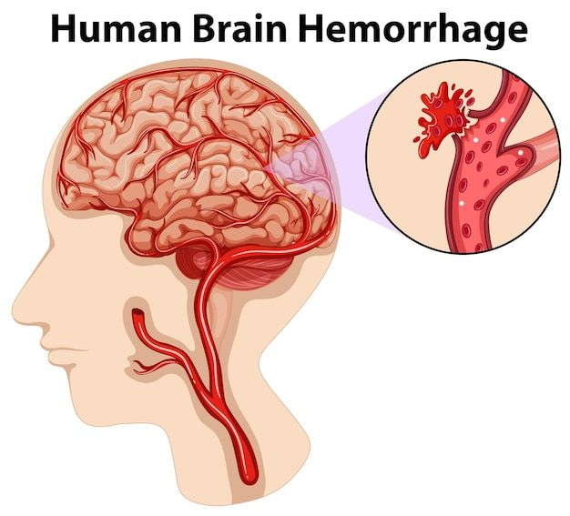
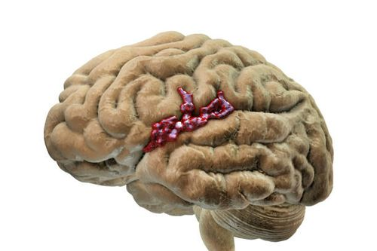
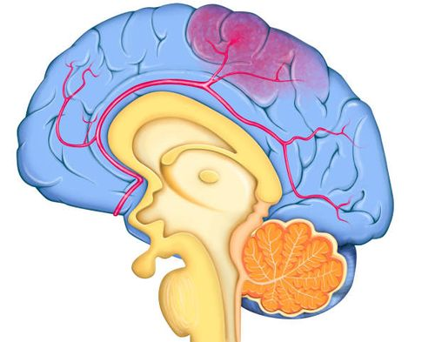
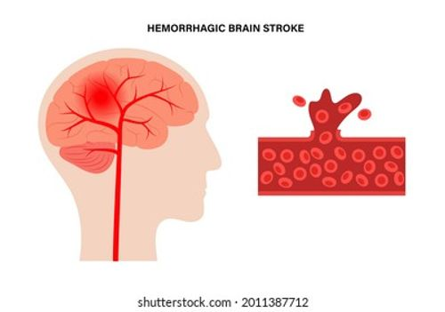
CONTENTS
INTRODUCTION
ABSTRACT
OBJECTIVES
EXISTING SYSTEM
PRPOSED SYSYTEM
ADVANTAGES OF PROPOSED SYSTEM
MODULES
SYSTEM DESIGN
SOFTWARE REQUIREMENTS
CONCLUSION

Slide 3
INTRODUCTION
Brain hemorrhage is a severe medical condition caused by internal bleeding within the brain tissues or surrounding areas.
Early and accurate detection is vital to prevent brain damage and save lives.
Traditionally, radiologists manually examine CT or MRI brain scans to detect hemorrhages — a process that is time-consuming, subjective, and prone to human error.
With the rapid advancement of Artificial Intelligence (AI), particularly Machine Learning (ML) and Deep Learning (DL), it has become possible to automate medical image analysis.
This project focuses on developing and comparing ML and DL models that can detect brain hemorrhage automatically from CT scan images with high accuracy.
The aim is to support radiologists in making faster, more reliable, and data-driven diagnostic decisions.
ABSTRACT

Slide 4
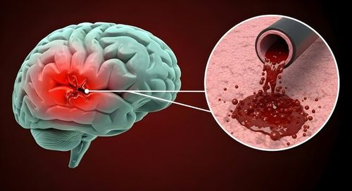
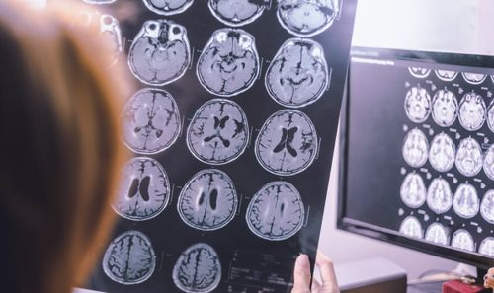
ABSTRACT
Brain hemorrhage is a life-threatening condition requiring early diagnosis.
This project proposes a Deep Learning-based CT image classification system.
Transfer Learning using InceptionV3 is applied for feature extraction.
The system performs binary classification: Hemorrhage vs Normal.
Image preprocessing and augmentation techniques improve model performance.
Model evaluation is done using Accuracy, ROC Curve, Sensitivity, and Specificity.
EXISTING SYSTEM

Slide 5
OBJECTIVES
To design an automated brain hemorrhage detection system.
To apply Deep Learning techniques for CT image classification
To implement Transfer Learning using InceptionV3 for feature extraction.
To improve diagnostic accuracy and reduce human error
To assist radiologists in faster clinical decision-making.
To develop a scalable and deployable web-based solution.
EXISTING SYSTEM

Slide 6
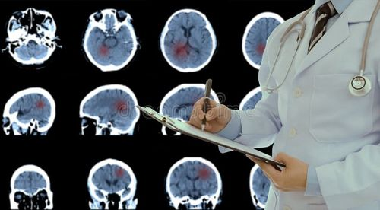
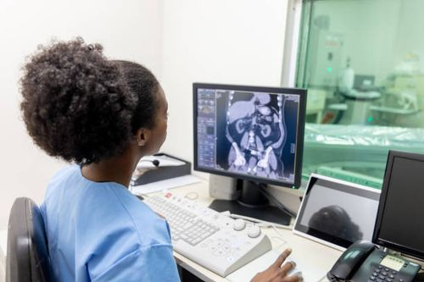
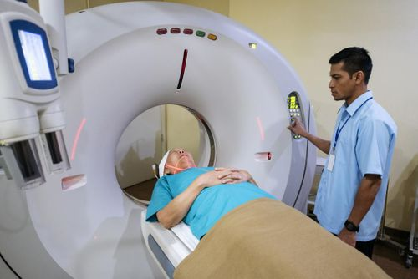


Slide 7

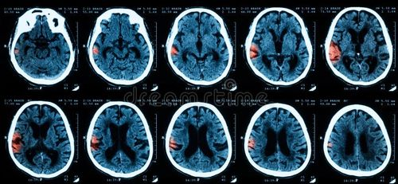
EXISTING SYSTEM
Brain hemorrhage diagnosis is primarily done through manual CT scan analysis.
Radiologists visually examine CT images to identify bleeding areas.
MRI, Angiography, and EEG are also used for neurological assessment.
Diagnosis depends heavily on expert interpretation.
No fully automated AI-based detection system in routine practice.

Slide 8

Draw backs of EXISTING SYSTEM
Manual analysis is time-consuming and delays diagnosis.
High dependency on experienced radiologists.
Possibility of human error in interpretation.
Large volume of CT scans increases workload.
Expensive diagnostic procedures in some cases.
Limited accessibility in rural or under-equipped hospitals.

Slide 9
PROPOSED SYSTEM
An automated Deep Learning-based brain hemorrhage detection system.
CT scan images are used as input for classification.
Image preprocessing and data augmentation are applied.
Transfer Learning using InceptionV3 model for feature extraction.
Binary classification: Hemorrhage vs Normal.
Model evaluation using Accuracy, Sensitivity, Specificity, and ROC Curve.
Deployment using Flask for web-based prediction.

Slide 10

Advantages of proposed system
Reduces diagnostic time and speeds up clinical decision-making.
High accuracy using CNN-based deep learning models.
Can handle large volumes of CT scan data efficiently.
Provides consistent and automated detection results.
Supports radiologists by serving as a reliable diagnostic aid.
ALGORITHMS USED

Slide 11
ALGORITHMS USED
1️⃣ Convolutional Neural Network (CNN)
Used for automatic feature extraction from CT scan images.
Detects important patterns like edges, textures, and bleeding regions.
2️⃣ Transfer Learning
Pre-trained weights from ImageNet are reused.
Reduces training time and improves accuracy with limited medical data.
3️⃣ InceptionV3 Architecture
Acts as the base model for deep feature extraction.
Final layers modified for binary classification (Haemorrhage / Normal).
4️⃣ Adam Optimizer
Updates model weights efficiently during training.
Helps in faster convergence.
5️⃣ Binary Cross-Entropy Loss
Measures the difference between predicted and actual labels.
Minimizes classification error during training.

Slide 12
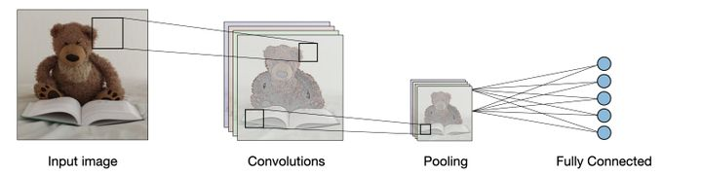
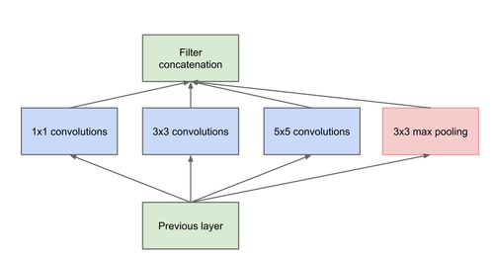
Cnn architecture
Inception v3 architecture

Slide 13
MODULES
1️⃣ Data Acquisition Module
Collection of CT scan images dataset
Categorized into Haemorrhage and Normal classes
2️⃣ Pre-processing Module
Image resizing and normalization
Data augmentation (rotation, flipping, scaling)
Noise reduction and quality enhancement
3️⃣ Model Training Module
Implementation of InceptionV3 using Transfer Learning
Fine-tuning of final classification layers
Training using Adam optimizer and Binary Cross-Entropy
4️⃣ Evaluation Module
Performance measurement using Accuracy
Confusion Matrix generation
Sensitivity and Specificity calculation
ROC Curve analysis
5️⃣ Deployment Module
Model integration with Flask framework
Web interface for image upload
Real-time prediction output display

Slide 14
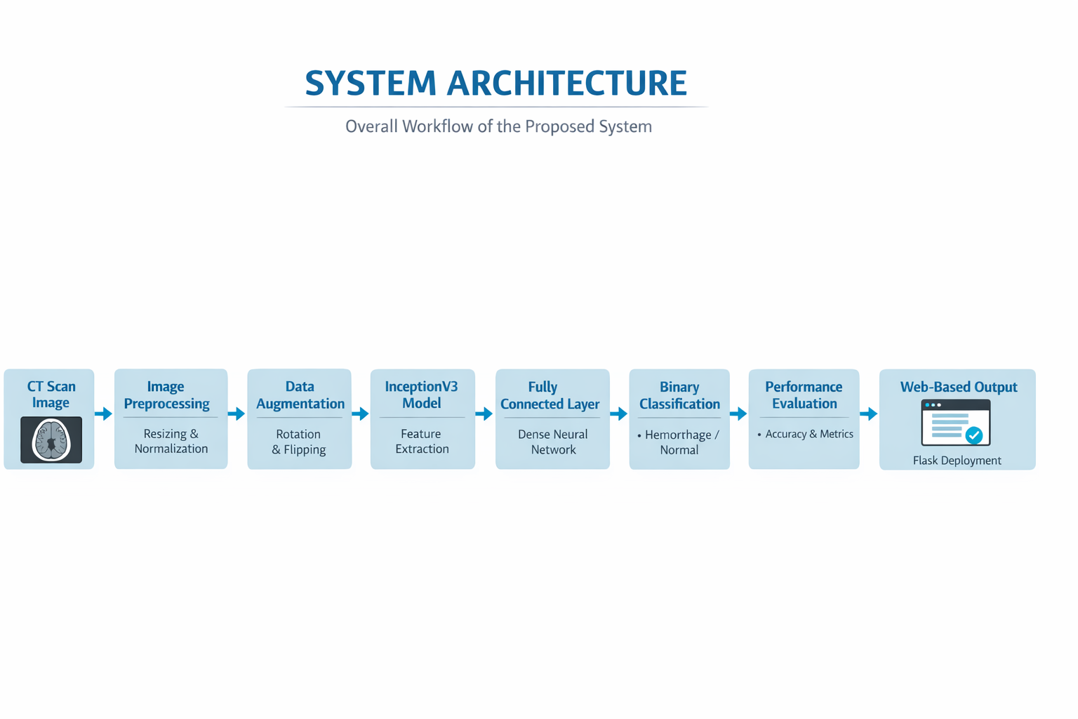
SYSTEM ARCHITECTURE

Slide 15

requirements
🔹Programming Language
Python 3.8
🔹 Libraries & Frameworks
TensorFlow
Keras
NumPy
Pandas
Matplotlib
Scikit-learn
🔹 Web Framework
Flask
🔹 Development Environment
PyCharm IDE / VS Code
Jupyter Notebook
🔹 Operating System
Windows 10 / Windows 11

Slide 16
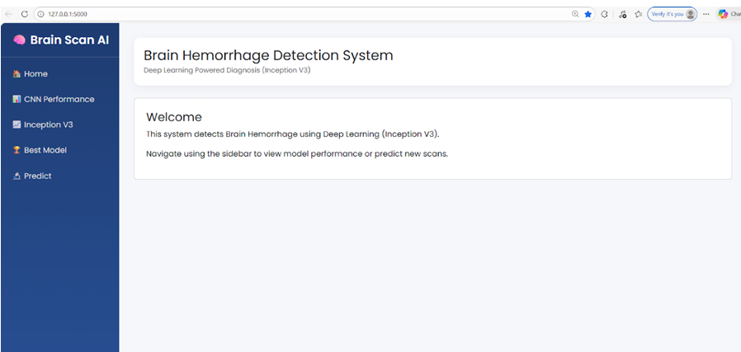
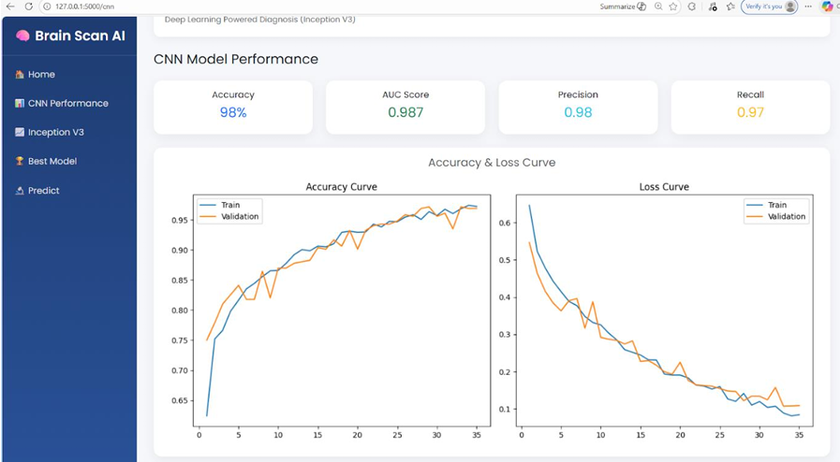
RESULTS

Slide 17
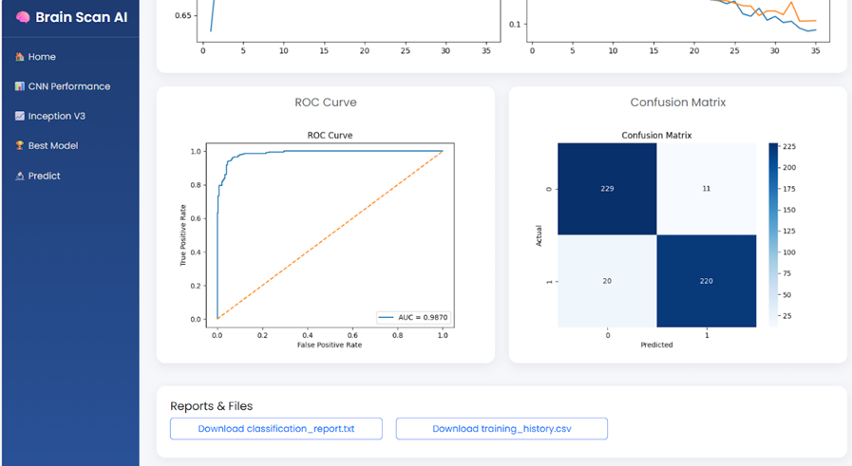
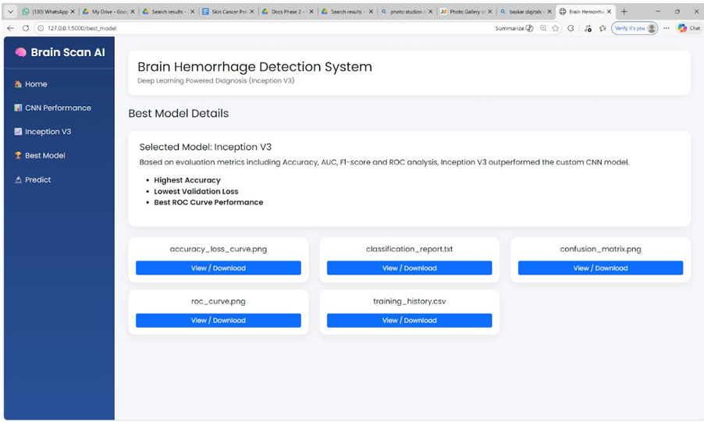

Slide 18
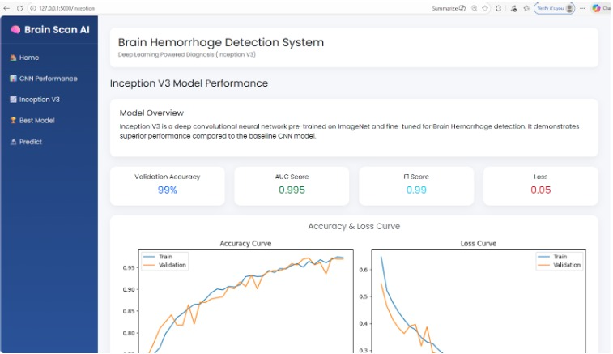
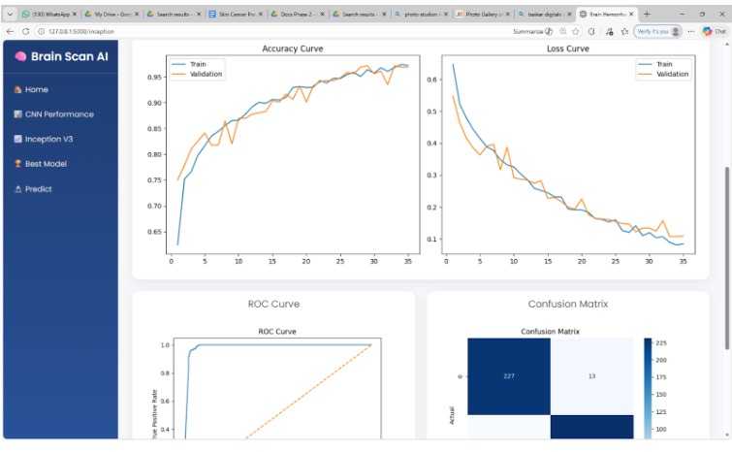
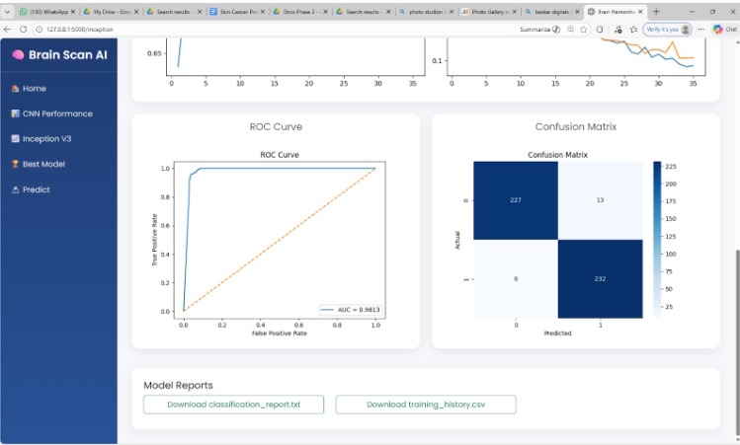

Slide 19
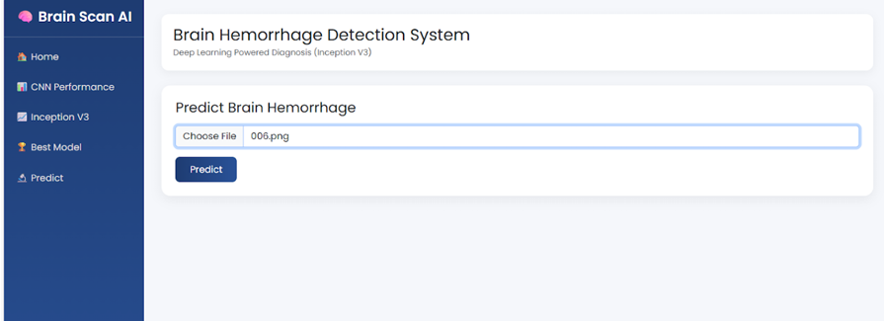
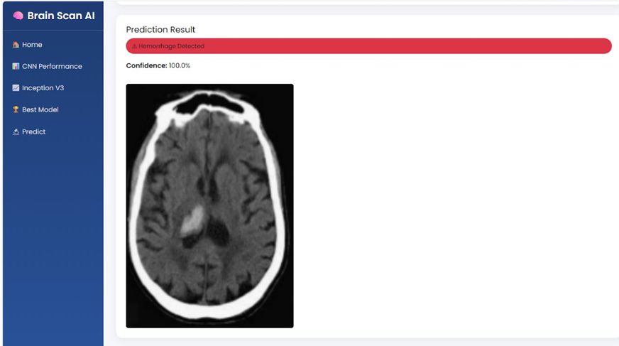

Slide 20
Future scope
Extension to multi-class hemorrhage detection (subtypes classification).
Integration of Explainable AI techniques like Grad-CAM for visualization.
Deployment in real-time hospital environments.
Cloud-based model integration for remote access.
Training with larger and diverse medical datasets.
Integration with hospital information systems (HIS).
a

Slide 21
Conclusion
This project successfully developed a deep learning-based brain hemorrhage detection system using CT scan images. Transfer learning was implemented using the InceptionV3 architecture to efficiently extract meaningful features and perform binary classification between hemorrhage and normal cases. Image preprocessing and augmentation techniques improved model robustness and performance. The system was evaluated using accuracy, sensitivity, specificity, and ROC curve, demonstrating reliable classification results. Finally, the trained model was deployed using Flask to provide a web-based prediction interface. Overall, the project highlights the effectiveness of artificial intelligence in assisting radiologists and improving early diagnosis of brain hemorrhage.
a

Slide 22
references
[1] J. Yang et al., “Machine Learning-Based Stroke Prediction Using XGBoost,” JMIR Medical Informatics, vol. 9, no. 6, 2021
[2] S. Chun et al., “Comparison of Machine Learning and Cox Regression for Stroke Risk Prediction,” Journal of the American Medical Informatics Association, vol. 28, no. 4, 2021.
[3] H. Alawad et al., “Automated Brain Hemorrhage Detection Using Genetic Algorithm-Based Feature Selection,” 2022.
[4] M. Ahmed et al., “Deep Learning-Based Brain Hemorrhage Classification Using CT Images,” IEEE Access, 2024.
[5] C. Szegedy et al., “Rethinking the Inception Architecture for Computer Vision,” Proceedings of CVPR, 2016.
a

Slide 23
Thankyou
a

